Slide 1

Finance Data Analysis
Main Kpi’s, Time Series, Segment wise, Profit Margin, Expense-Discount, Units Sales, Country Wise Analysis

Slide 2
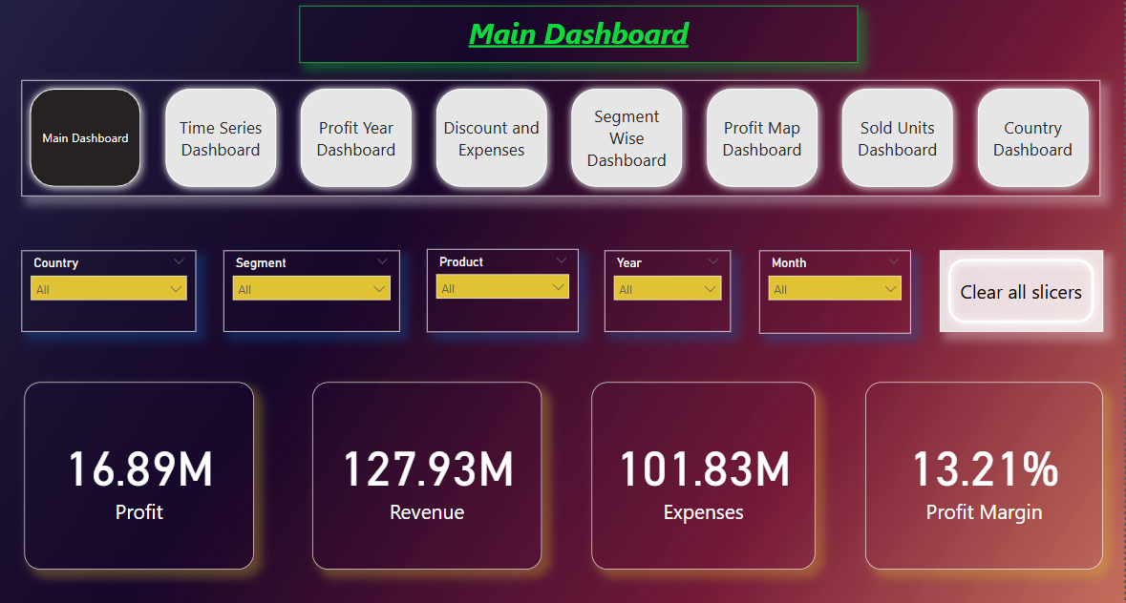
Finance Data Analysis
- Main Overview - KPI’s Profit, Revenue, Expenses, Profit Margin

Slide 3
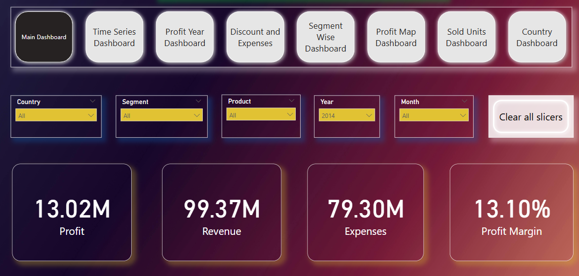
Main Kpi’s Part 1
- Year 2014,- Profit, Revenue, Expenses, Profit Margin

Slide 4
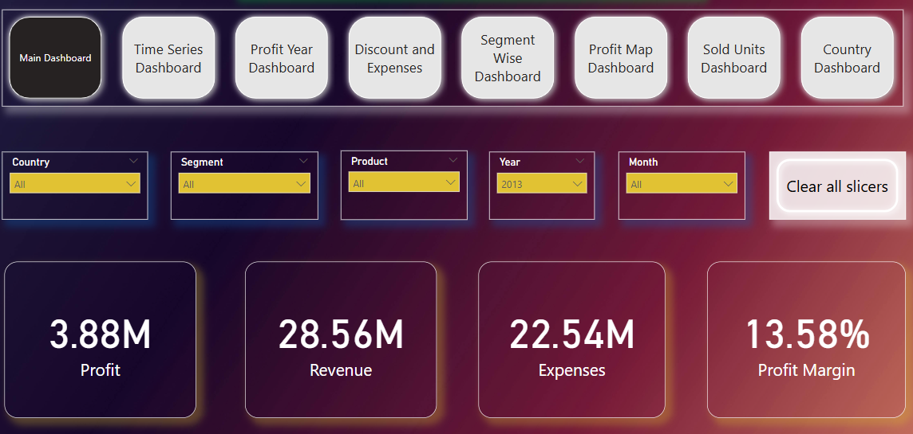
Main Kpi’s Part 2
- Year 2013,- Profit, Revenue, Expenses, Profit Margin

Slide 5
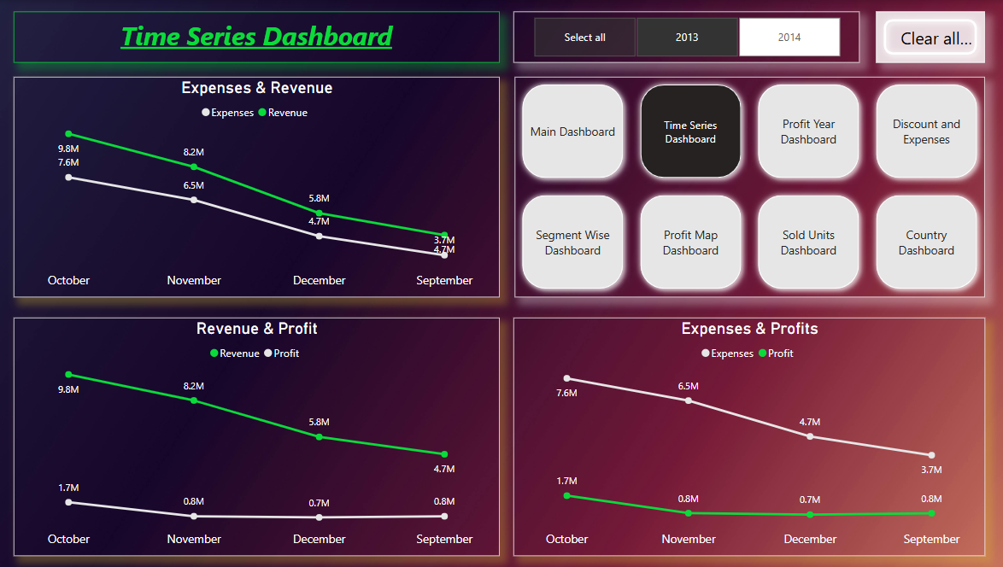
Timely Analysis part 1
Year 2013,- September is least in Expense, Revenue and Profit
October is highest in Expense, Revenue and Profit

Slide 6
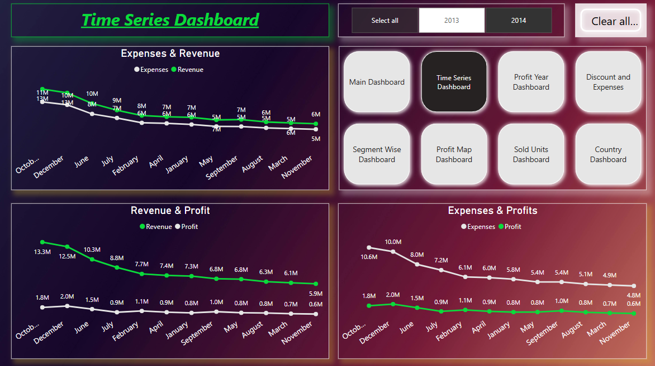
Timely Analysis part 2
Year 2014,- March, November are least in Expense, Revenue and Profit.
October, December are highest in Expense, Revenue and Profit.

Slide 7
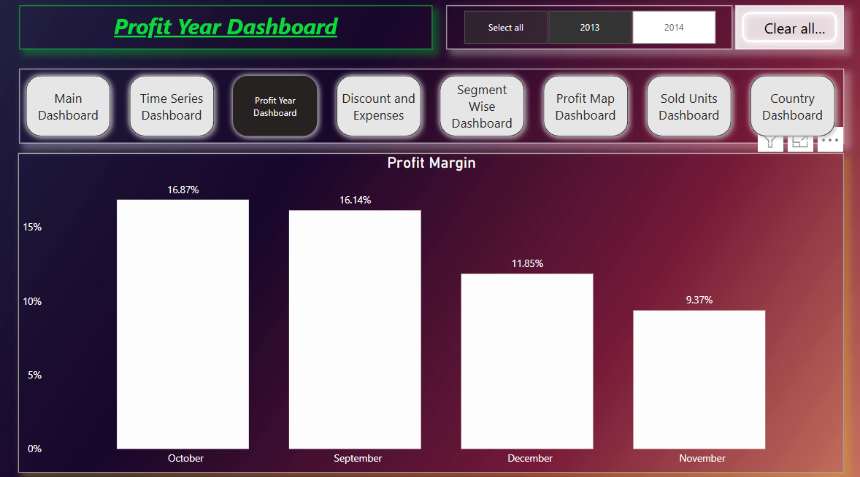
Profit Margin part 1
Year 2014,- October, September are highest Profitable Margin year

Slide 8
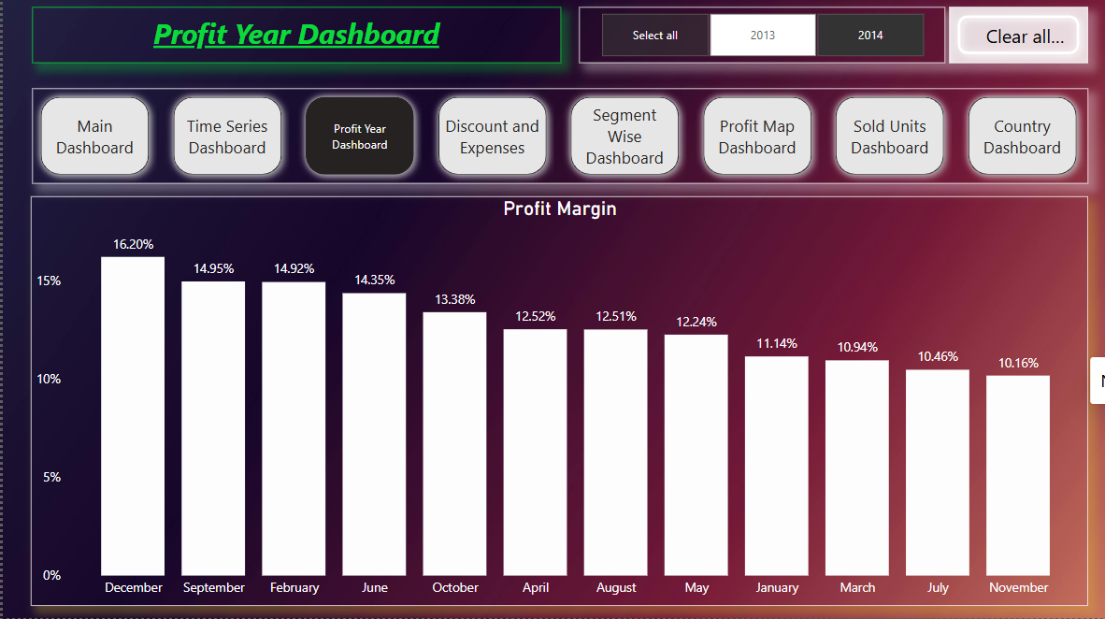
Profit Margin part 2
Year 2013,- December at rank 1st. And, Sep and Feb at rank 2nd .

Slide 9
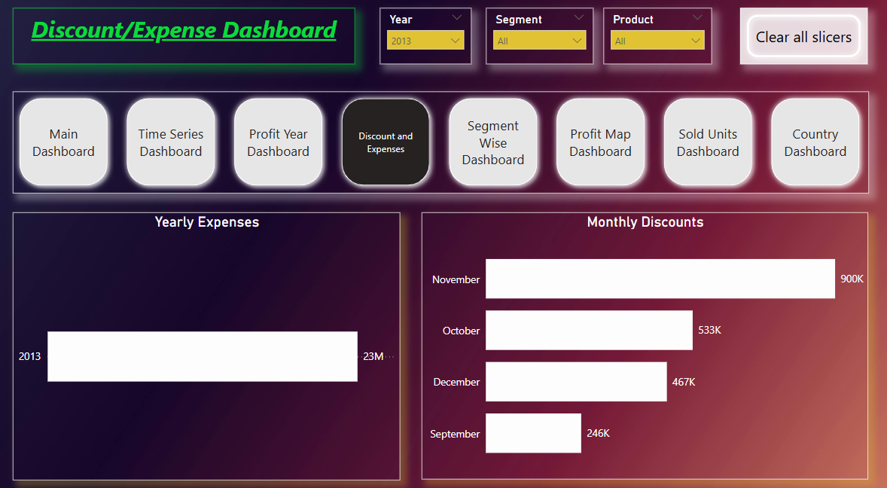
Discount and Expense part 1
Year 2013

Slide 10
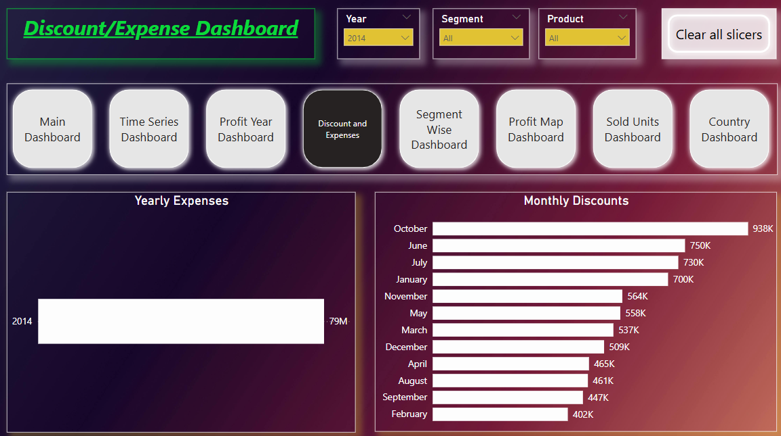
Discount and Expense part 2
Year 2014

Slide 11
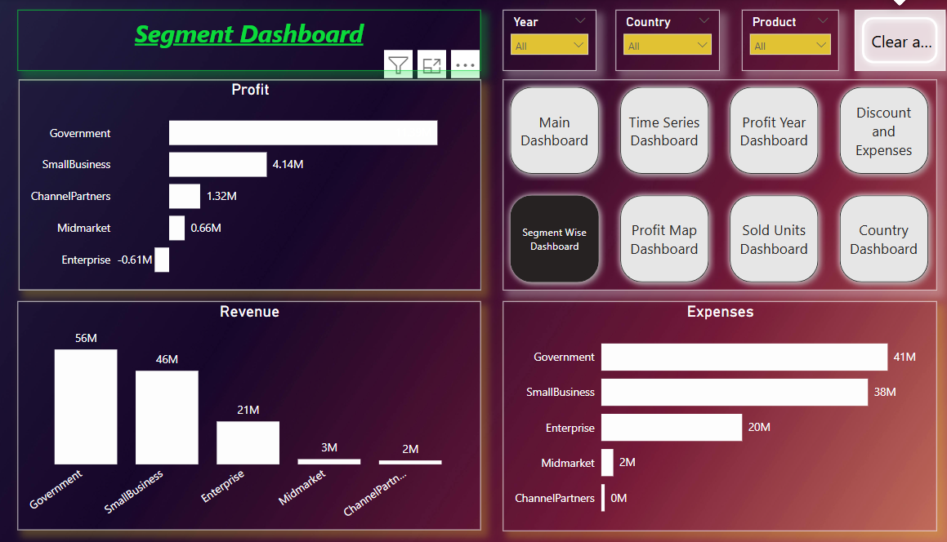
Segment Analysis
As Government Segment is highest in Profit, Revenue and Expense.
In Enterprise, we got loss instead profit while expense is very high in this segment.

Slide 12
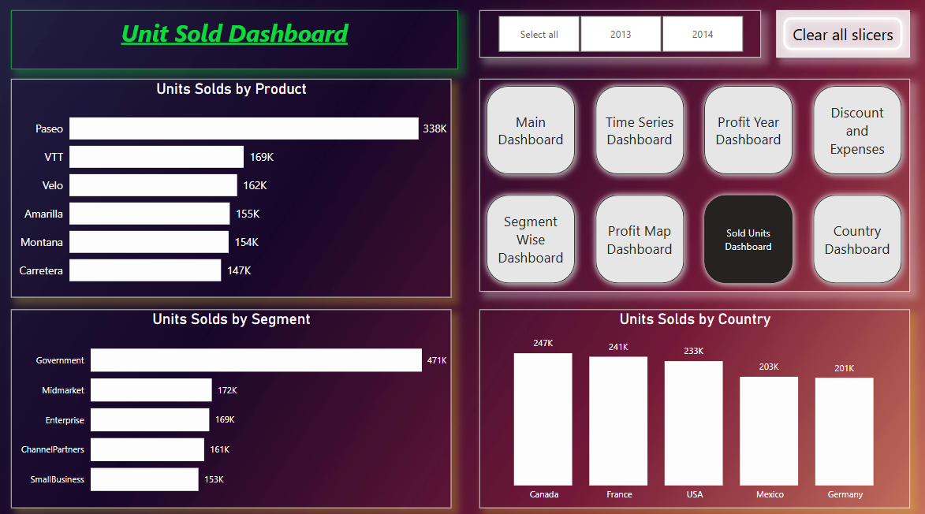
Unit Sold Analysis
Overview of Unit Sold by product segment and country.

Slide 13
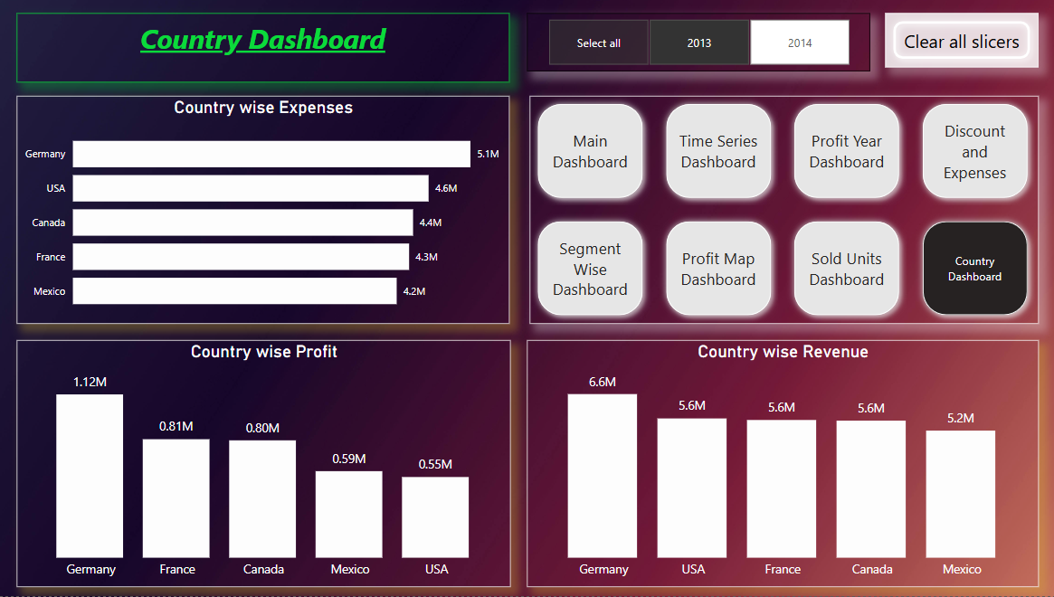
Country wise Analysis Part 1
In 2013, Germany in Rank 1st in Profit, Revenue and Expense.

Slide 14
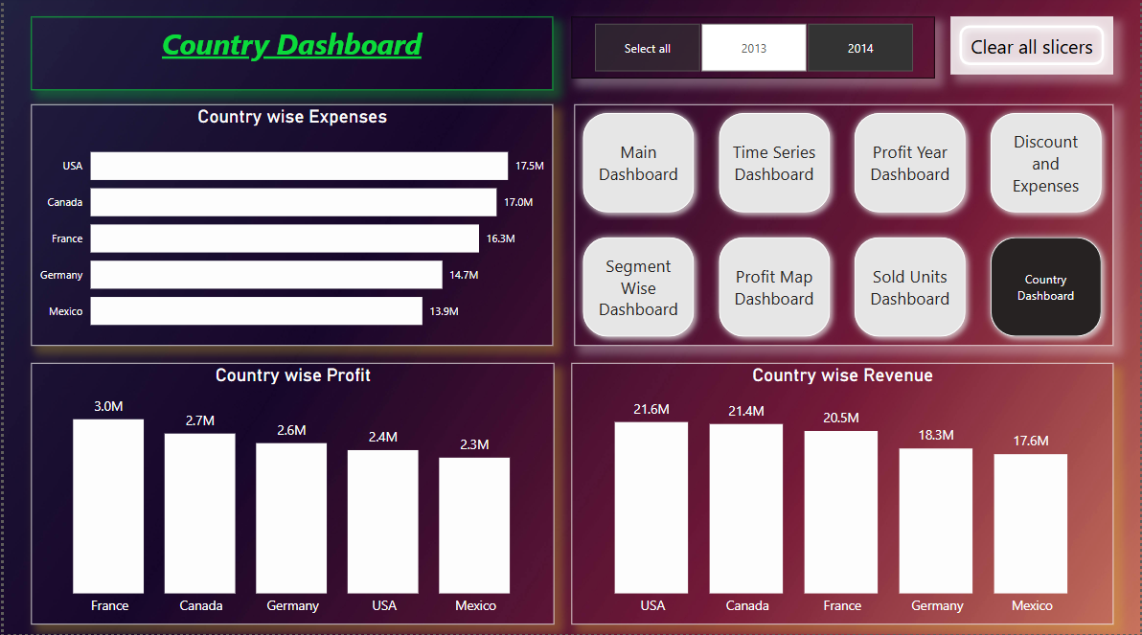
Country wise Analysis Part 2
In 2014, USA in Rank 1st in Revenue and Expense but France in Profit.

Slide 15
Thank you

